Slide 1
How to Predict the popularity of
NY Times Opinion pieces
Ben Johnson-Laird

Slide 2
Goal & Data
Goal To help editors and writers know what articles the public might like
Data Loaded one month’s Opinion pieces from Jan 12th - approx 170 articles.
For each article captured:
Full text
The number of user comments (popularity measure)
Dependent variable is derived from # of user comments

Slide 3
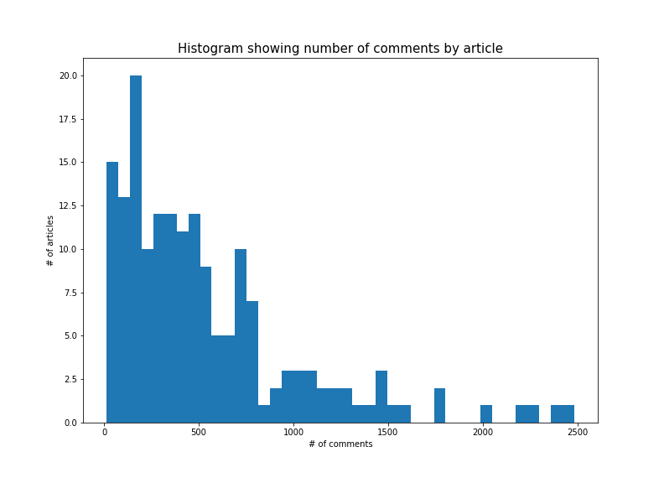
Frequency distribution of # of user comments
Varying threshold for what counts as popular:
Top % | # of comments
5 | > 1,509
10 | 1,217
15 | 998
20 | 788
25 | 725
30 | 649
35 | 553
40 | 496
45 | 460

Slide 4
Initial Model - Bag of words (TF-IDF)
Defining popular as being in the Top N% (by comment count)
Predictor top N% popular Op Eds | F1 micro score
N = 50% | 75%
N = 40% | 55% but everything classified as unpopular!
Notes:
F1 = 2 * (precision * recall) / (precision + recall)
Micro -- Calculate metrics globally by counting the total true positives, false negatives and false positives.
TF-IDF, short for term frequency–inverse document frequency

Slide 5
Word2vec, GloVe & document classification
Word2vec (2013) created by Tomas Mikolov el al. at Google. The output represents a word as a multidimensional vector typically at least 50 dimensions. Each dimension encodes some semantic features.
Words with similar meaning tend to cluster together in the N-dimensional space.
GloVe (Stanford) provides pre-trained word vectors. This work used 50 & 300 dimensional vectors trained on Wikipedia & Gigaword.
Document classification
Weight of a document is the mean vector of the weighted word vectors in the document. The weights are are derived from inverse document frequency (IDF)

Slide 6
Word2vec results using GloVe (50d) & tf-idf
5-fold cross-validated results, training set: 138, hold out: 35
Predictor top N% popular Op Eds | F1 micro score | Popular Op Eds (% of hold out test)
N = 40% | 68% | 37 - 40%
N = 30% | 79% | 29 - 31%
N = 25% | 79% | 23 - 26%
Predictive ability peaks where popularity is defined as the top 25% of articles by user comments

Slide 7
Conclusion & Future Steps
It’s clear that the meaning of an article it critical to predicting reader popularity. Word2vec performs significantly better than a pure-syntactic bag of words approach From a rough analysis it’s clear that the reaction to an article can elicit strong reader reaction in the comments. For example comments like the following were highly liked:
Snippet from first two sentences of comment | Number of recommendations
This is the way dictators rise. | 8,349
..as if she couldn't formulate intelligent, informed questions; … he seemed to become angry that she didn't fit his stereotype of her. | 6,640
It's appalling that you would cite the "thinnest evidentiary record"... | 5.333

Slide 8
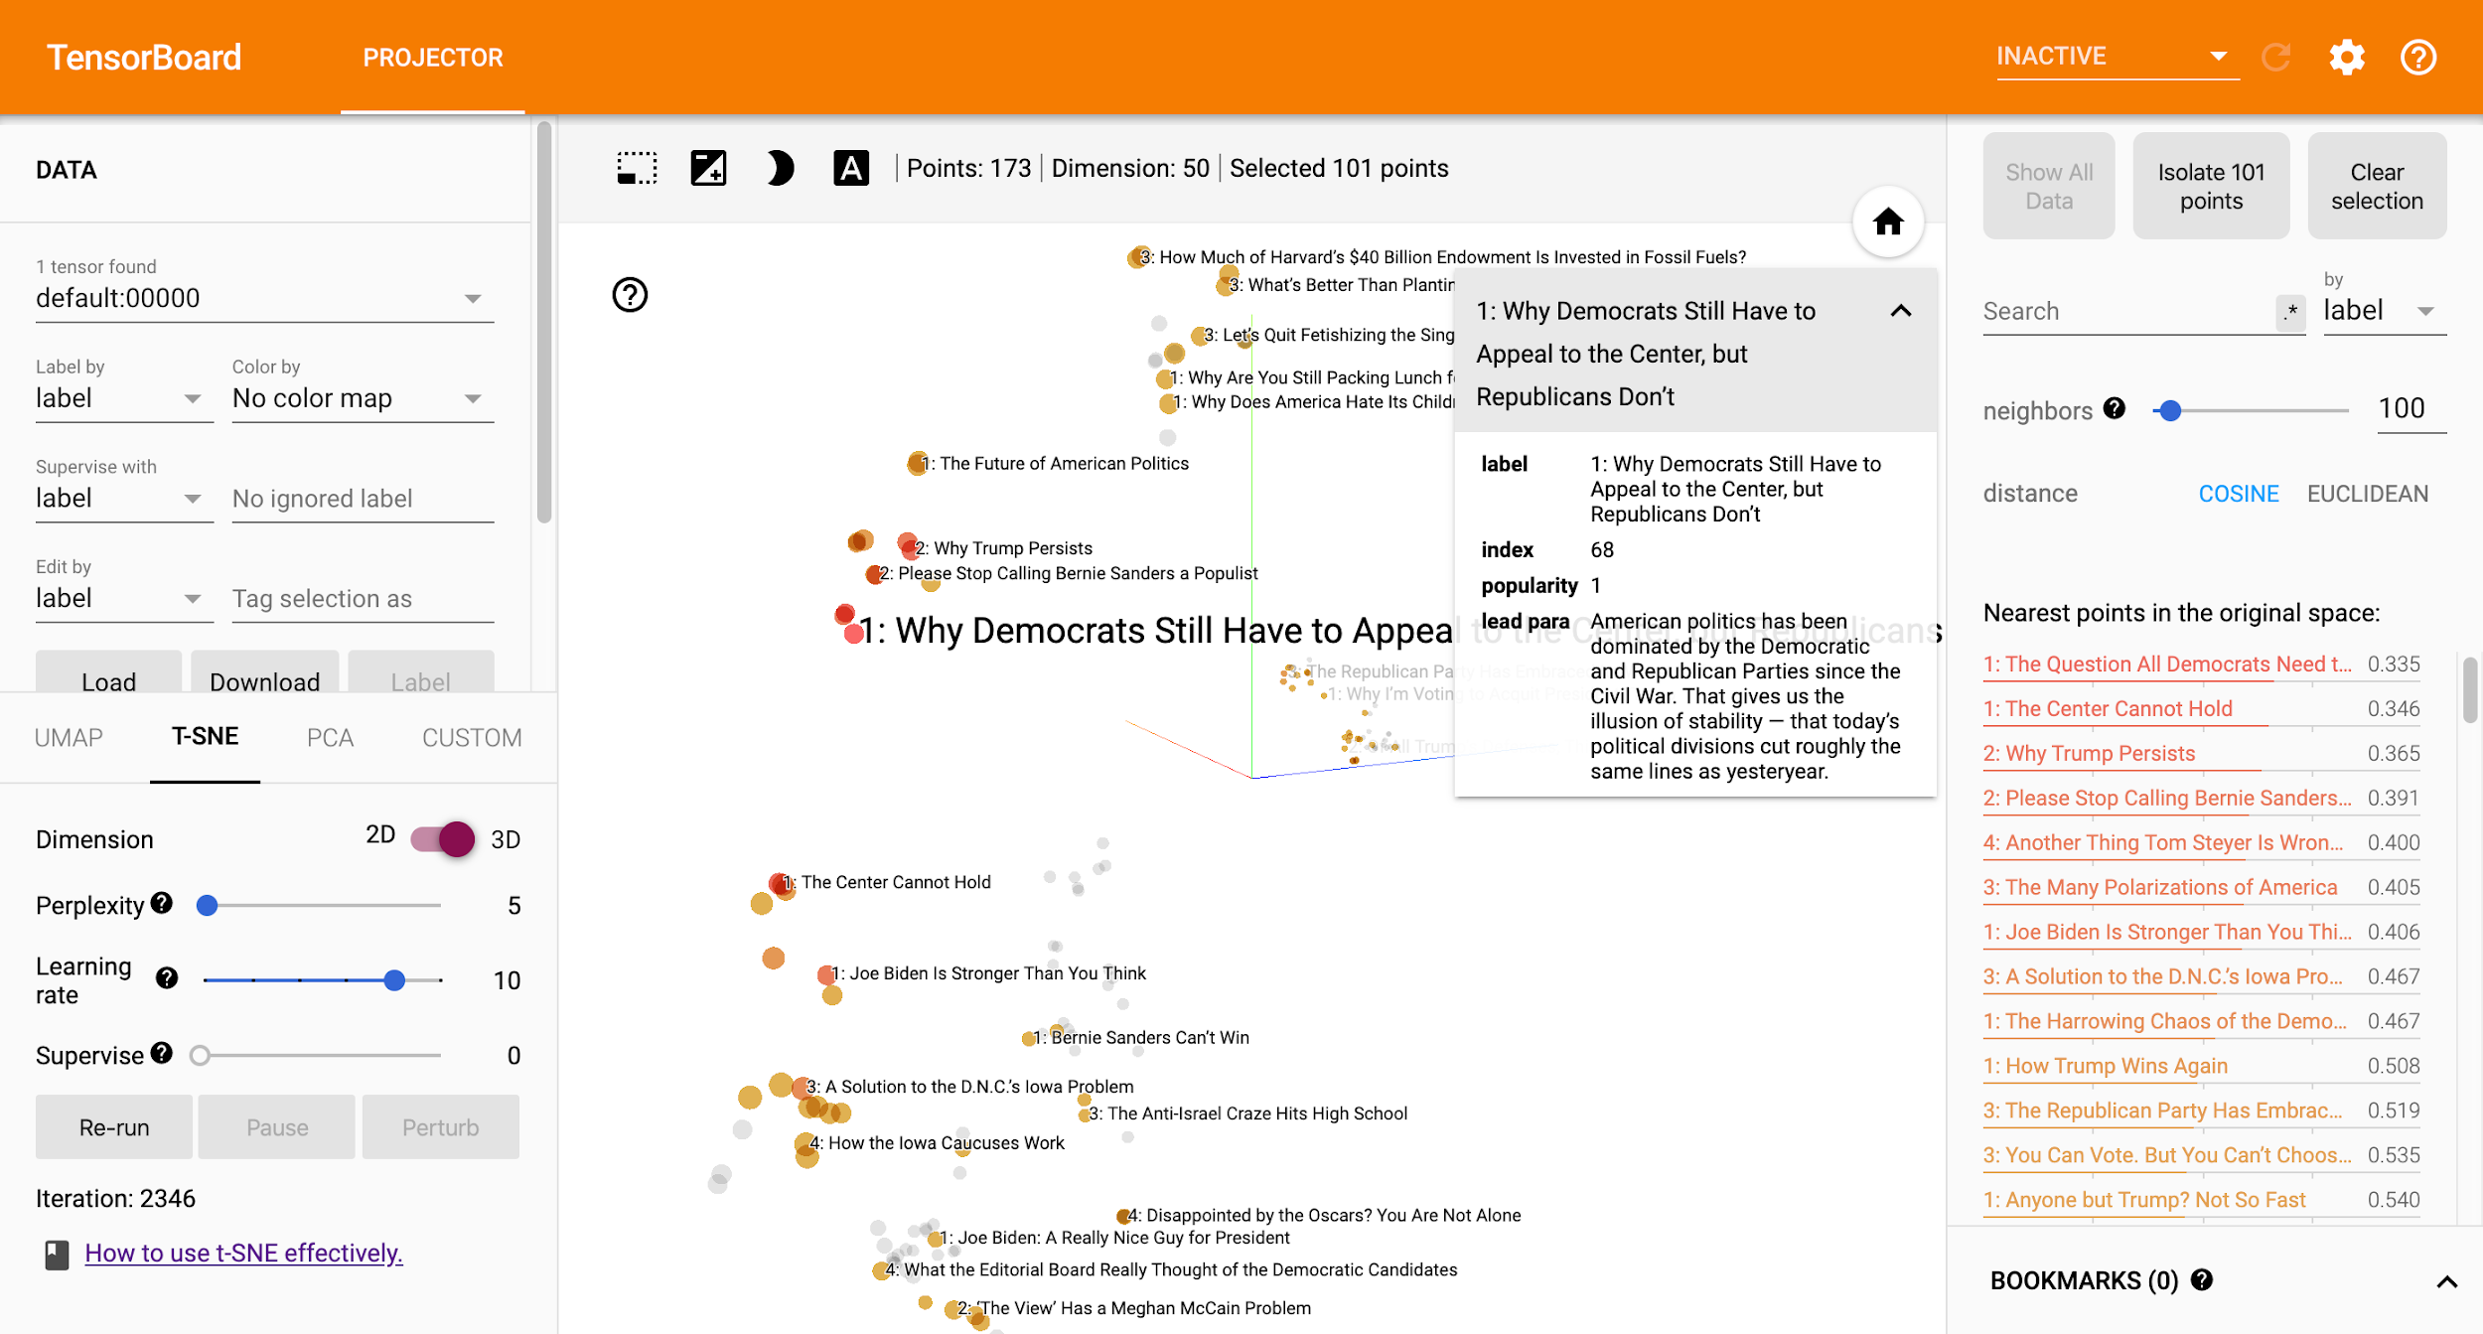
Visualizing the 50-dimension vectors

Slide 9
Acknowledgements
Nadbor Drozd - Text Classification With Word2Vec
Jeffrey Pennington, Richard Socher, and Christopher D. Manning. 2014. GloVe: Global Vectors for Word Representation
Chris Manning. Natural Language Processing with Deep Learning. https://www.youtube.com/watch?v=OQQ-W_63UgQ

